Slide 1
Microservices and DevOps
DevOps and Container Technology
Networking 101
Henrik Bærbak Christensen

Slide 2
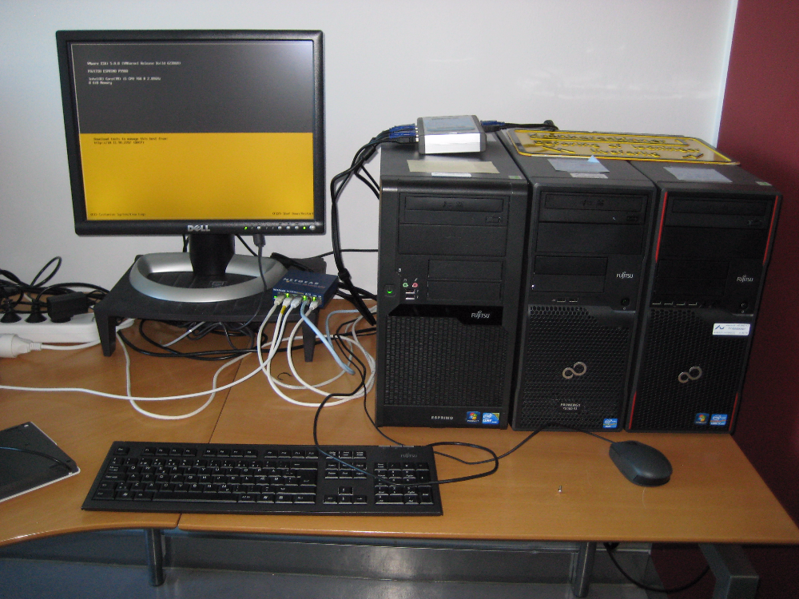
A Network
… in CS is basically two or more machines connected by electrical wires that allows to send signals between the machines…

Slide 3
A Network
My first exposure: RS232 on Z80 CPUs
Today’s web: TCP/IP over Ethernet

Slide 4
TPC/IP
Transmission Control Protocol and Internet Protocol
By the US Department of Defence (DARPA)
Key Idea
Segment transmission into Packets (”Datagrams”)
Layered architecture, each with specific responsibilities (roles!)

Slide 5
TCP/IP
By Jsoon eu (talk) - I (Jsoon eu (talk)) created this work entirely by myself., CC BY-SA 3.0, https://en.wikipedia.org/w/index.php?curid=29962617

Slide 6
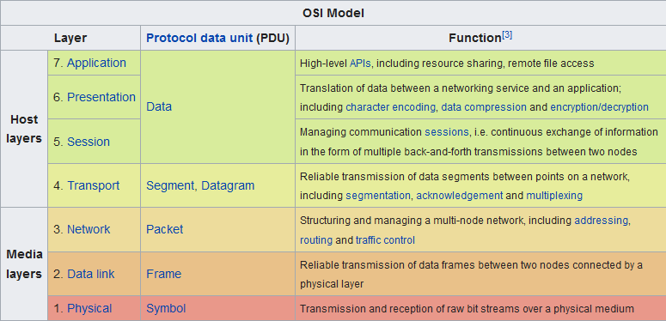
OSI Model
Another but similar model

Slide 7
TCP/IP Layers
Transport layer
TCP Reliable, ordered, error-checked data delivery
Transmission Control Protocol
Network / Internet Layer
IP Relaying datagrams across networks
Internet protocol
Physical + Data Link Layer
802.3 Ethernet Hardware and cables
802.11 WiFi Cables gone

Slide 8
Internet Protocol
IP: Send datagram

Slide 9
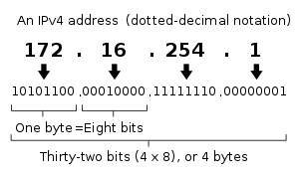
IP
Defines the terminology that we use and it pops up even at the software level
Every computer on the network has an address
Type ‘ifconfig’/’ipconfig’ to find yours
Some ranges are reserved
10.*.*.*, 172.16.*.*., 192.168.*.* are private networks
127.0.0.1 is localhost = myself

Slide 10
IP and Ports
So given an IP (like 91.221.196.224) you uniquely identify a computer
The OS of that computer expose 64K ports
Also predefined port numbers
7: echo (‘ping’)
20: ftp
22: ssh
80: HTTP
Thus
91.221.196.224:80 is the HTTP port of a specific computer
As port 80 is active it is probably a web server

Slide 11
Ports
On Linux, all ports below 1024 are reserved for ‘root’
Above that, it is ‘free game’ to assign/use a port, but you may interfere with other programs that have picked one...

Slide 12
Datagram
So, for node A and node B to communicate some data
Say, a request for a web page, and the server reply
A creates a request
N datagrams (the data segmented into packet size)
Each datagram contains
Part i of the full data
Destination IP address Who is to receive
Source IP address Who should have the reply
B creates a reply
Of course the same ☺

Slide 13
Domain Name System
IP addresses are a bit hard to remember, right?

Slide 14
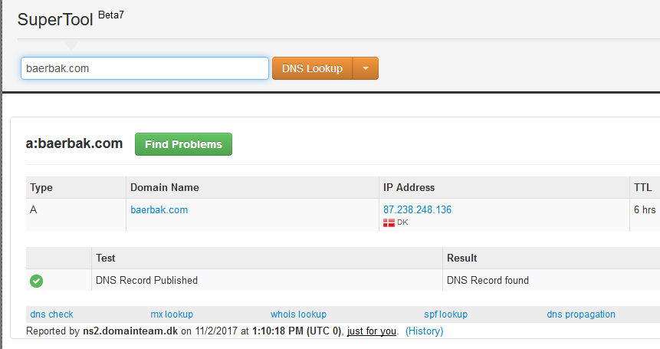
DNS
Who can remember 87.238.248.136 ???
DNS (Domain Name System) are Name Services
Computers that translate names into IP addresses

Slide 15
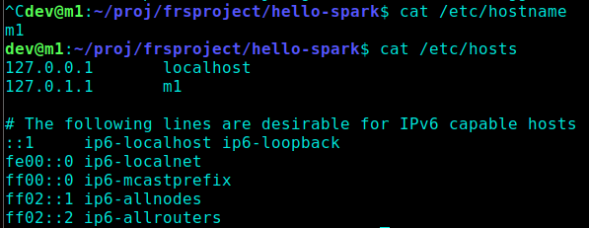
Local names
Any computer has its own name
Normally you give it a name when installing
On Linux you may change it by editing a few files
Localhost is 127.0.0.1 which is the IP address of the computer itself!

Slide 16
You Own DNS
You can actually maintain your own DNS by editing the hosts file on Linux

Slide 17
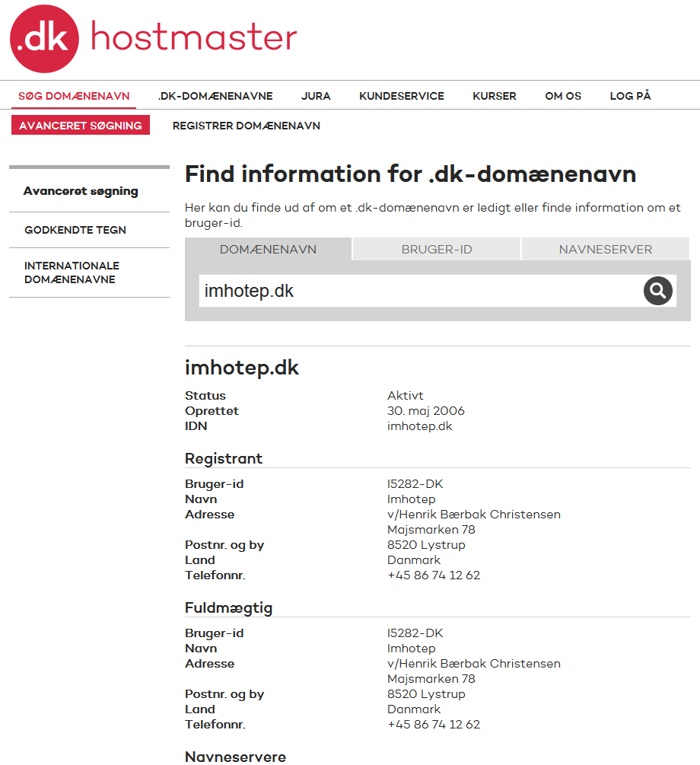
Global DNS
Only works on my machine ☹
So – how do I get a global domain name?
For ‘.dk’ domains DK-Hostmaster keeps track of all Danish domains

Slide 18
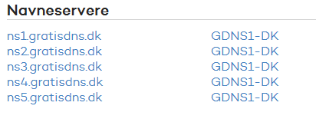
Name Servers
But you only register the domain, you need a Name Server to handle the actual lookup
I log into my dk-hostmaster account and assign the name of my selected name service provider

Slide 19
Create a New Name
Scenario: Mathilde wants her own MineCraft server
I do
Rent a virtual machine on DigitalOcean
So I get an IP address of that machine
I log into my ‘GratisDNS’ account and create an A record

Slide 20
Resolving Names

Slide 21
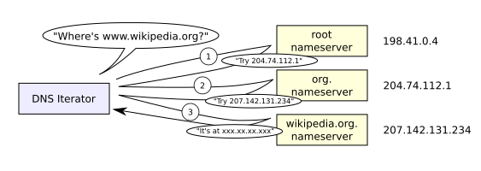
Name Resolution
Any node on the IP network has a (local) Name Server registered, the one to contact first
Windows: ‘nslookup’
Linux: ‘nslookup’ ☺
Algorithm: ”If I do not know, I know who knows”
Picks the name apart right to left!
dk before imhotep before www

Slide 22
Performance
Of course, contacting 3-8 servers just to resolve a DNS entry is extremely expensive
Caching Tactic: ‘Maintain multiple copies of data’
Each DNS server caches the lookup
So my local DNS server knows the address immediately the next time I ask
Browsers maintain their own caches!
No need to talk to the DNS at all

Slide 23
Time To Live
But but – what happens when IPs change then?
All the caches will send requests to the old node?
The principle of delegation is used in DNS
I move my MineCraft server to another provider – and get a new IP address
The DNS system has to adapt: TTL: TimeToLive
Takes up to 24 hours world-wide

Slide 24
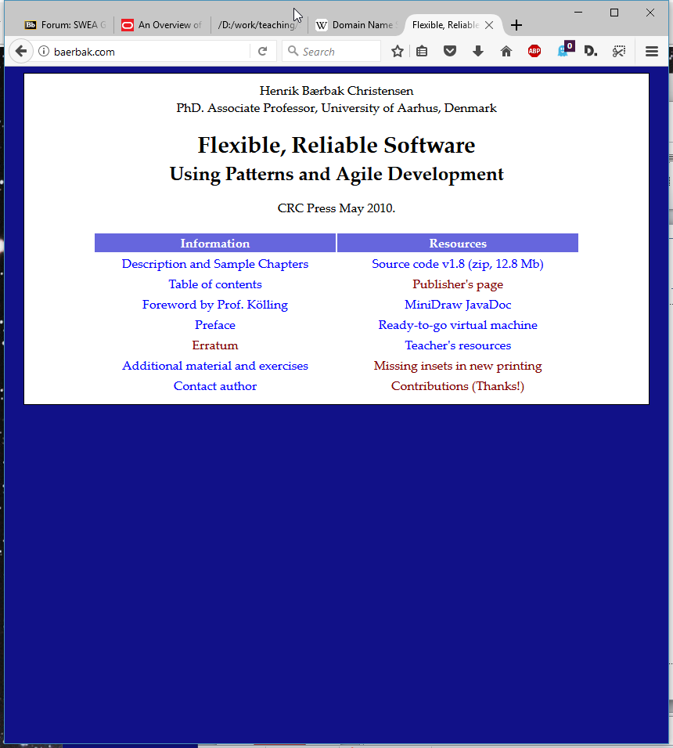
So…
baerbak.com will become
http://www.baerbak.com
Firefox calls DNS server
Translate it into IP address
Firefox will then send a http request to port 80 on that ip address
… which will return a HTML document

Slide 25
Summary
To send a datagram, you have to know the address of the receiver
Every node in an IP network has an IP address
IP address xxx.xxx.xxx.xxx (or IPv6)
Nodes for a wider audience use DNS servers to assign a hostname to a specific IP address
www.dr.dk instead of xxx.xxx.xxx.xxx
Every node has 65.536 ports
Quite a few below 1024 are reserved

Slide 26
TCP
The last piece of the puzzle

Slide 27
Actually, rather hidden
IP splits data into packets/datagrams and sends them
But they get lost!
They become garbled
They arrive out-of-order
TCP introduce reliability
Get packet 1, 2, 3, 5, 7, 6...
Request packet 4 again, and 7 as it was garbled
Forward the full data by putting segments in correct order

Slide 28
Network Address Translation
Weird Behaviour Warning

Slide 29
Segmenting Networks
Organizations, projects, homes create their own LANs.
Security, convenience, performance
Example:
At home, I have a router that assigns each connected node an IP in the 192.168.x.x space
But at any time there are thousands of machines with IP 192.168.1.38
How does ‘www.imhotep.dk’ know which computer to return the HTML document to, then???

Slide 30
NAT
So NAT in my router simply change IP:port of the datagrams so the web server returns to the router instead; once it has been received, the router forwards to the local node

Slide 31
Implications
NAT makes networking behave ‘weird’:
I can see you, but you cannot see me!
My home computer can see the full internet, but no computer on the internet can see mine!
They can only see my ISP’s computer, which is the only one that can see my router, which is the only one who can see my computer!
VMWare Player does NAT between your host machine and the course VM you are running

Slide 32
Implications
VMWare Player does NAT between your host machine and the course VM you are running
It installs an additional network on the host
Therefore your host has multiple IP addresses, on multiple networks
Meaning host and VM can communicate on the 192.168.85.* network. Remember to use that for local testing!

Slide 33
Handy commands

Slide 34
Some Nice Network Commands
Debug 101
Can my computer see the other computer???
‘ping www.imhotep.dk’
‘ping 192.168.1.37’
What is my IP?
Windows: ipconfig / linux: ifconfig

Slide 35
Relation To Docker

Slide 36
Docker
Docker networks have it’s own internal DNS
Docker run -- name mydb …
Will assign the container the name ‘mydb’ which can be used to contact it by any container on the same network (but not ‘host’)

